Slide 1
Oops Concept

Slide 2
OOPs (Object-Oriented Programming System)
Object means a real-world entity such as a pen, chair, table, computer, watch, etc. Object-Oriented Programming is a methodology or paradigm to design a program using classes and objects. It simplifies software development and maintenance by providing some concepts:
Object
Class
Inheritance
Polymorphism
Abstraction
Encapsulation

Slide 3
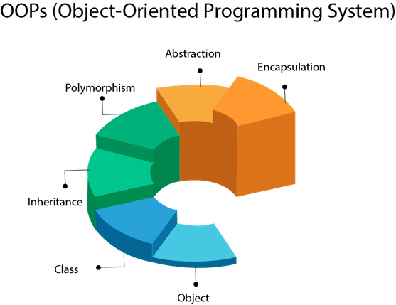

Slide 4
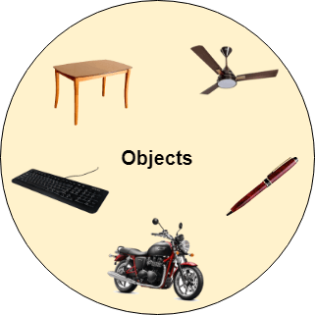
Object:
Any entity that has state and behavior is known as an object. For example, a chair, pen, table, keyboard, bike, etc. It can be physical or logical.
An Object can be defined as an instance of a class. An object contains an address and takes up some space in memory.
Example: A dog is an object because it has states like color, name, breed, etc. as well as behaviors like wagging the tail, barking, eating, etc.

Slide 5
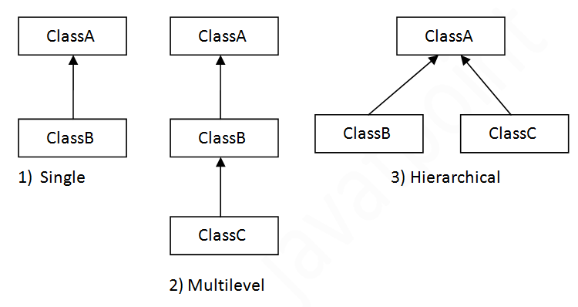
Class:
Collection of objects is called class. It is a logical entity.
A class can also be defined as a blueprint from which you can create an individual object. Class doesn't consume any space.
Inheritance:
When one object acquires all the properties and behaviors of a parent object, it is known as inheritance. It provides code reusability. It is used to achieve runtime polymorphism.

Slide 6
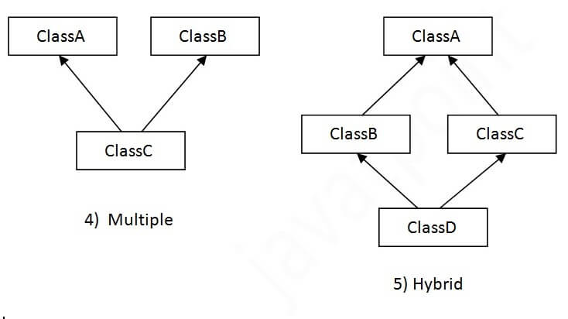
Multiple inheritance is not supported in Java through class.

Slide 7
Benefits of Inheritance
Inheritance offers several advantages, including:
Code Reusability: Inherited members from a superclass can be reused in subclasses, reducing redundant code and promoting a modular approach to software development.
Hierarchical Organization: Inheritance facilitates the creation of well-structured class hierarchies, improving code readability and maintainability.
Polymorphism: Subclasses can override superclass methods, allowing for polymorphic behavior, where methods can behave differently based on the object type at runtime.
Easier Maintenance: Changes made to a superclass automatically propagate to its subclasses, ensuring consistency and simplifying maintenance efforts.

Slide 8
Polymorphism:
If one task is performed in different ways, it is known as polymorphism. For example: to convince the customer differently, to draw something, for example, shape, triangle, rectangle, etc.
There are two types of polymorphism in Java: compile-time polymorphism and runtime polymorphism. In Java, we use method overloading and method overriding to achieve polymorphism
Abstraction:
Hiding internal details and showing functionality is known as abstraction. For example phone call, we don't know the internal processing. In Java, we use abstract class and interface to achieve abstraction

Slide 9
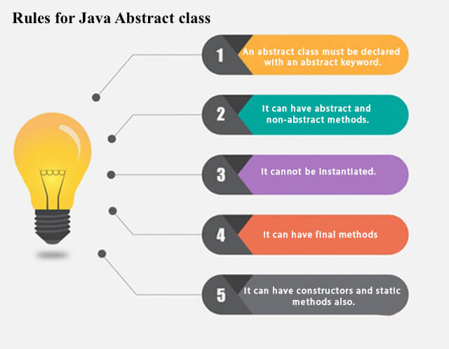
.

Slide 10
Encapsulation:
Binding (or wrapping) code and data together into a single unit are known as encapsulation. For example, a capsule, it is wrapped with different medicines.
We can create a fully encapsulated class in Java by making all the data members of the class private. Now we can use setter and getter methods to set and get the data in it.
The Java Bean class is the example of a fully encapsulated class.

Slide 11
thank you

